Slide 1
Plagiarism, Similarity Index

Slide 2
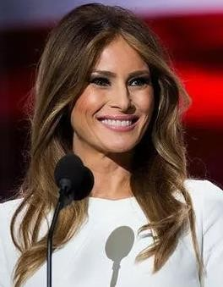
Melania Trump, wife of Donald Trump
Her Plagiarism: Melania Trump's speech from the 2016 Republican National Convention appeared to plagiarize First Lady Michelle Obama's speech to the Democratic National Convention in 2008.
5
https://www.ranker.com/list/high-profile-cases-of-plagiarism/janaegreen

Slide 3
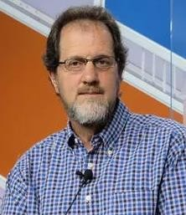
H. Gilbert Welch, a Health Policy Expert At Dartmouth
His plagiarism: In September 2018, Welch stepped down from his position at Darthmouth College after being accused of plagiarizing the work of other professors for a paper published in the New England Journal of Medicine.
The paper discussed the benefits of breast cancer screenings. Associate
Professor Samir Sonji claimed Welch did not credit him and Hiram Beltran-Sanchez, a researcher from UCLA, whose methodologies and investigations were not properly cited. Dartmouth agreed Welch could stay at the school if he agreed to stop teaching and to make Soneji a co- author on said paper, but Welch would not.
"I cannot in good conscience accept the demand that I make the complainant an author - much less the demand that I make him the first author," Welch said.
6
https://www.ranker.com/list/high-profile-cases-of-plagiarism/janaegreen

Slide 4
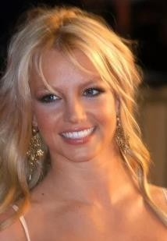
Britney Spears, pop singer
Her Plagiarism: In 2005, Spears and her record label, Sony/BMG Music, were sued by Steve Wallace for allegedly stealing his lyrics.
Wallace claimed that her 1998 hit, "Sometimes," was similar to the song he submitted to a lyrics contest the year before.
Although the case was dismissed, a new plagiarism hit on Spears alleges
her single, “Hold It Against Me” copies several lines written by the Bellamy Brothers in 1970.
7
https://www.ranker.com/list/high-profile-cases-of-plagiarism/janaegreen

Slide 5
Types of Plagiarism
Type of plagiarism | Severity
Paraphrasing plagiarism | Serious
Mosaic Plagiarism | Serious
Verbatim Plagiarism | Serious
Global plagiarism | Serious
Self-plagiarism | Moderate
Incorrect citation | Moderate
Non-existent source | Serious
https://www.scribbr.com/plagiarism/types-of-plagiarism/
8

Slide 6
Paraphrasing plagiarism
Paraphrasing is the act of rephrasing a text in your own words.
Paraphrasing is the most common type of plagiarism.
Paraphrasing itself is not plagiarism so long as you properly cite your sources.
However, paraphrasing becomes plagiarism when you read different sources,
pull out the key points and then rewrite these points as if they were your own ideas.

Slide 7
Mosaic plagiarism (patchwork plagiarism)
Patchwork plagiarism (also known as mosaic plagiarism or incremental plagiarism) is similar to paraphrasing.
It is when you copy and paste together pieces of different texts to create a new text.
This includes rewording pieces of sourced material while keeping the structure of the original
texts.
This type of plagiarism requires a little more effort and is more insidious than simply incorrectly paraphrasing a source, but plagiarism checkers like Turnitin can still easily detect this kind of plagiarism.

Slide 8
Verbatim plagiarism (Copy & Paste)
You commit verbatim plagiarism when you directly copy text from a source and paste it in your own document without properly citing the information.
If the majority of the structure and words are the same, then it is verbatim plagiarism, even if you delete or change a couple words here and there.
If you want to use the exact same words from a source, you need to quote the original source by
putting the copied text in quotation marks and including an in-text citation.

Slide 9
Citing incorrectly
The first step in avoiding plagiarism is citing your sources.
However, a citation is not enough; you need to correctly cite all your sources.
You can either paraphrase (rephrase a text), quote or summarize the original source.
Make sure to follow the guidelines of your citation style. If you’re not sure which citation style to
use, you can read our quick guide to citation styles.

Slide 10
Global plagiarism
Global plagiarism means using someone else’s work while passing it off as your own.
The words are not yours and are therefore plagiarized.
This includes having a friend or family member write your essay for you or
paying for an essay.

Slide 11
Plagiarizing yourself (self-plagiarism)
Self-plagiarism can be tricky and is frequently unintentional.
There are a couple of different versions of self-plagiarism; the more serious being turning in a paper you already submitted for a grade to another class. Because you have turned this paper in already, it is no longer new and original work.
Self-plagiarism can also occur when you use ideas or phrases from your previous papers or
assignments.
As long as you consult your professors to check whether doing so falls within your institution’s policies, citing previous papers you have written is not considered self-plagiarism.

Slide 12
Source Citing a non-existent
You’re searching for a source to back up a statement in your paper but are unable to find it. The last thing you should do is make up a non-existent source or include inaccurate information about a source. These are also forms of plagiarism.
By doing so, you mislead readers of your paper by pretending that a theory or statement is supported by a source.

Slide 13

Plagiarism
The word plagiarism comes from the Latin word meaning "kidnapper”
Plagiarism is avoidable if you
Understand what plagiarism is
Understand what citation is
Look at your writing like your reader does

Slide 14
Plagiarism – What is it?
Submitting a paper you didn’t write yourself - Cheating
Copying from sources and pretending you wrote it yourself - Cheating
Using a source and saying it is a different source – Cheating
You use author’s ideas and words without giving author credit
This is main source of plagiarism!
Confusing – even for professionals!

Slide 15
Talking to your reader
Make clear who said what
Sometimes you use the exact same words as author
Sometimes you paraphrase author
But always, you make it clear which words/thoughts are author’s, which are
yours
Readers understand because you follow certain conventions (agreed upon ways
of doing things)

Slide 16
Writing conventions
When borrowing author’s exact same words
Cite your author
Use quotation marks around borrowed words
Even when paraphrasing author’s information
Cite your author
Always, when reporting author’s information
Cite your author

Slide 17
Cite your author!
Cite? What does “cite” mean?
According to President Obama, the economy… He goes on to say…
Lee (2007) argues that inflation will…
The army’s actions were “incomprehensible and reprehensible” (Adams &
Morten, 232).
All bold words above are examples of citation
Different journals/conferences and dissertations require different citation
styles – look for your citation style

Slide 18
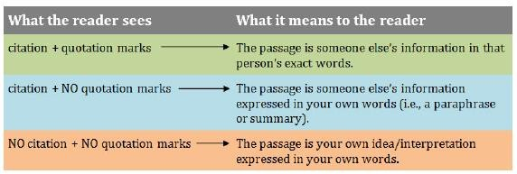
What are you telling your reader?

Slide 19

What are you telling your reader?
Example
The link between cell phone use and grade point average needs further investigation.

Slide 20

What are you telling your reader?
Example
Survey results found that cell phone use is “negatively predictive of overall grade point average” (Svinicki 19).

Slide 21
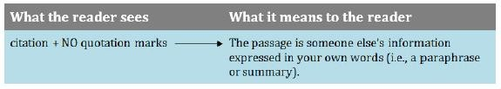
What are you telling your reader?
Example
Survey results found that increased cell phone use corresponds to lower grade point average (Svinicki).

Slide 22
Plagiarism can happen
You paraphrase an author’s words but you do not cite the author
You just told your reader that it is YOUR idea But in reality, it is the AUTHOR’s
idea
Maybe you forgot or misunderstood the convention, but still…it is plagiarism.

Slide 23
Lets take a quiz [1/2]
Excerpt from article by Svinicki
Survey results from 1500 college students about their cell phone use found that increased use was negatively predictive of overall grade point average.
Student’s sentence
Svinicki’s research on cell phone use found that increased use was negatively predictive of overall grade point average.

Slide 24
Lets take a quiz [1/2]
Excerpt from article by Svinicki
Survey results from 1500 college students about their cell phone use found that increased use was negatively predictive of overall grade point average.
Student’s sentence
Svinicki’s research on cell phone use found that increased use was negatively predictive of overall grade point average.
Red text should be inside quotation marks because they are the author’s exact words!

Slide 25
Lets take a quiz [2/2]
Excerpt from article by Svinicki
Survey results from 1500 college students about their cell phone use found that increased use was negatively predictive of overall grade point average.
Student’s sentence
Survey results found that increased cell phone use corresponds to lower grade point average (Svinicki).

Slide 26
Lets take a quiz [2/2]
Excerpt from article by Svinicki
Survey results from 1500 college students about their cell phone use found that increased use was negatively predictive of overall grade point average.
Student’s sentence
Survey results found that increased cell phone use corresponds to lower grade point average (Svinicki).
No. This is NOT plagiarism -- The student paraphrased Svinicki’s information and cited Svinicki.

Slide 27
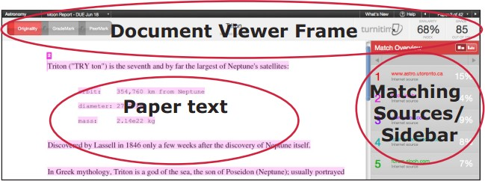
Assignment Submission
All the assignments submitted to turnitin software

Slide 28
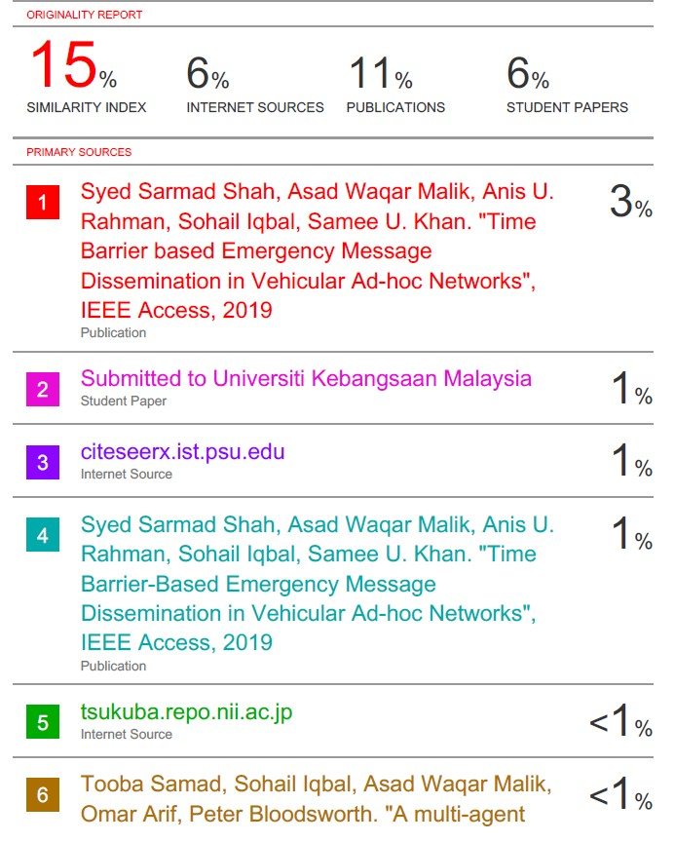
Plagiarism Report

Slide 29
University of Malaya Plagiarism
Similarity Index allowed up to – 25%
How to avoid Plagiarism - a handbook for postgraduate students.
http://um-staging.cloudapp.net:8034/docs/librariesprovider80/download-rules-
regulations/how_to_avoid_plagiarism_a_handbook_for_postgraduate_students.pdf?sfvrsn=2

Slide 30
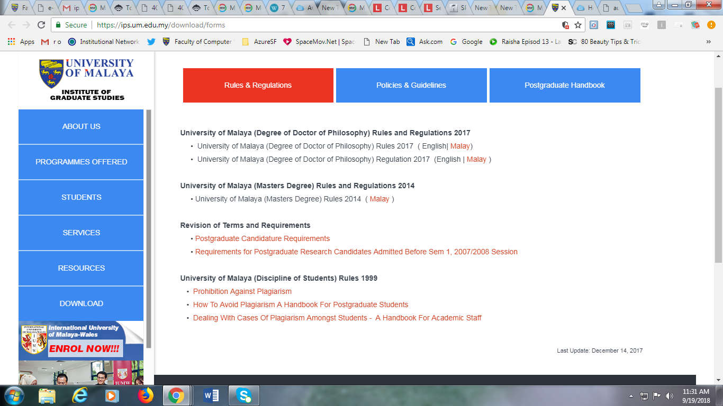
University Malaya IPS Rules and Regulation

Slide 31
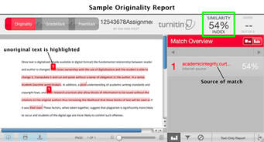
Turnitin Report

Slide 32
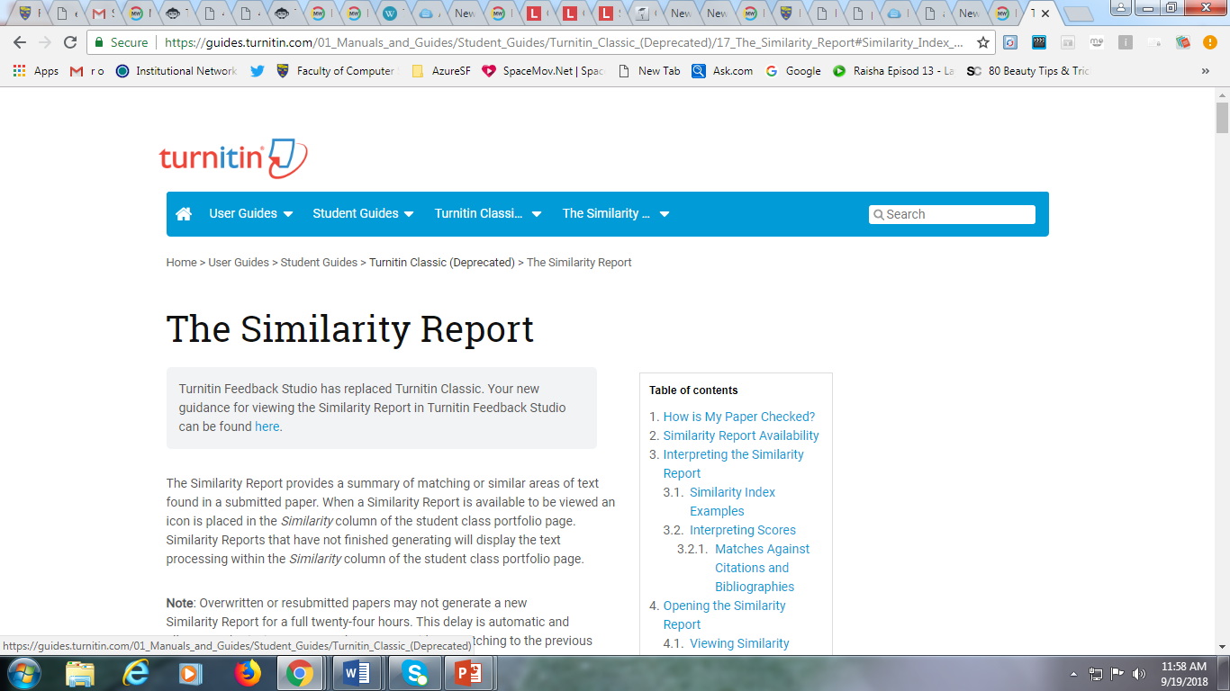
Similarity Index

Slide 33
Reference
Thanks to Katie Levin in Student Writing Support (SWS) for her “What Are You Telling Your Readers?” approach to plagiarism
http://writing.umn.edu/sws/assets/pdf/plagpres.pdf

